Slide 1
Game Development
Muhammad Kamran
CS Department attock
m.Kamran@cuiatk.edu.pk

Slide 2
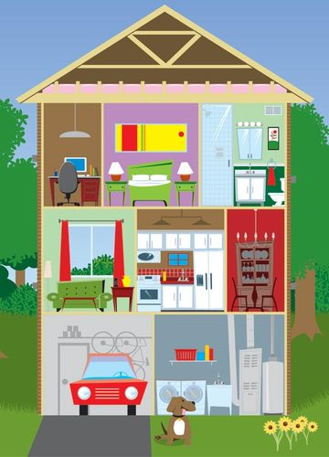
Construction Analogy

Slide 3

Target Audience

Slide 4
Target Audience
Demographics
Age, Gender, Culture
Core VS. Casual Gamer

Slide 5

Neighborhood
Windows
Location, Location, Location
MAC
Xbox
Plystation
WII

Slide 6

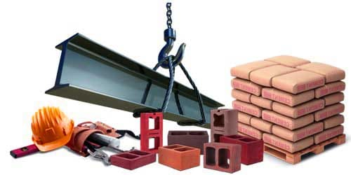
Construction Material

Slide 7
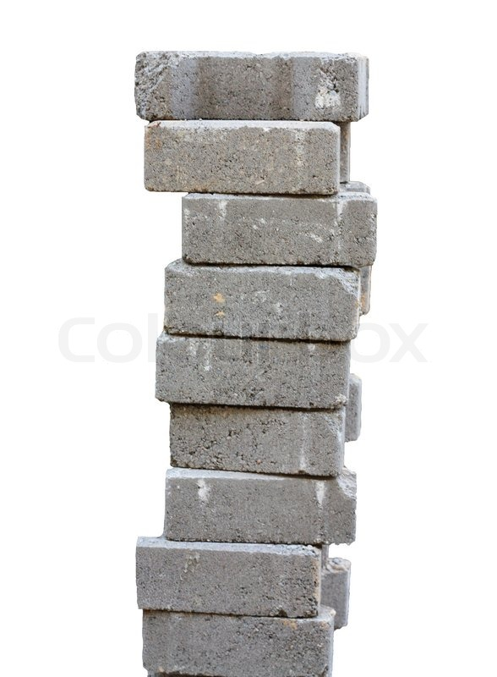
Game Technology
Graphics
Sounds
Finishing
Game Specific Code
Framing
Middleware/Engine
Foundation
Operating System
Earth
Hardware

Slide 8

Game Technology
Graphics
Sounds
Audience
Game Specific Code
Design
Middleware/Engine
Operating System
Technical Details
Hardware

Slide 9
Game Development Team
Construction | Game Development
Architect | Designer
Manager/Supervisor | Producers
Mason, Carpenter, Electrician, Plumber | Programmers /Designers
Interior Designer | Artists, Musician

Slide 10
Game Development Team
Small Team (1-5)
Designer
Prog
Programmer
Design
Art
Artist

Slide 11
Game Development Team
Small Team (1-5)
Producer
Manages Schedule
Budget
Communication
Odd jobs
Prog
Medium Team (6-25)
Producer
Design
Art

Slide 12
Game Development Team
Small Team (1-5)
Prog
Level Designer
Medium Team (6-25)
LD
Technical Artist
Scr
Prod.
Scripters
Large Team (25+)
Design
Art
TD

